Slide 1
SIT113 Cloud Computing and Virtualisation
Week 10, Class 2
AWS – Scaling and VPC

Slide 2
Outline
AWS
Auto Scaling
Virtual Private Clouds

Slide 3
Auto Scaling
Several EC2 instances (VMs) can be placed into an Auto Scaling Group.
Auto Scaling ensures that:
you have the correct number of instances available to handle the current workload
instances are launched/terminated as workload increases/decreases
Auto Scaling is free.
But you still need to pay for non-free VMs, etc.

Slide 4
Auto Scaling - Manual
Manual Scaling requires you to provide minimum, desired and maximum values
This ensures that:
the number of instances is between minimum and maximum values, inclusive
the number of instances matches the desired number of instances

Slide 5
Auto Scaling - Schedule
A schedule is useful for predictable workloads
Scaling is:
performed automatically
based on time/date values

Slide 6
Auto Scaling – On Demand
Scaling by policy enables you to control scaling based on particular values.
For example, you can specify to increase the number of VMs when the average CPU utilization is:
greater than a percent value
for some time period.
You should have two policies:
one for scaling out (launching instances)
one for scaling in (terminating instances)

Slide 7
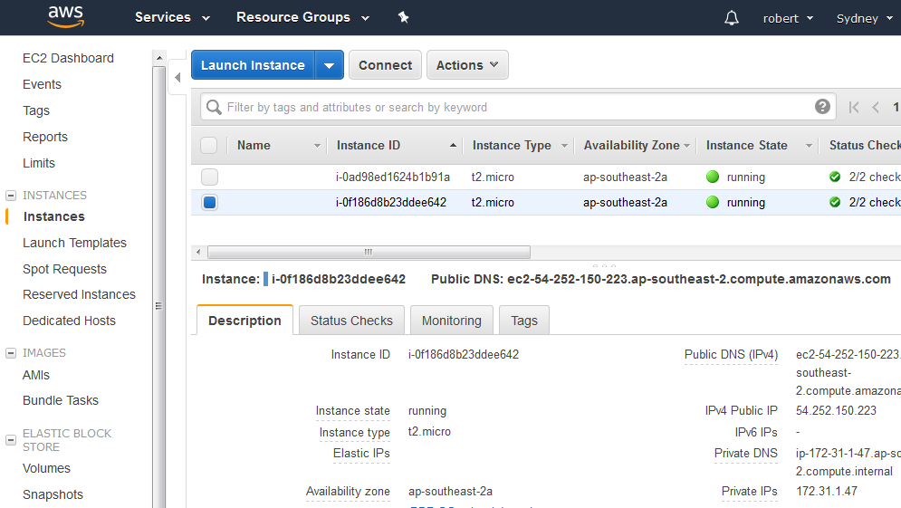
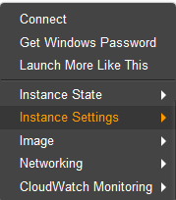
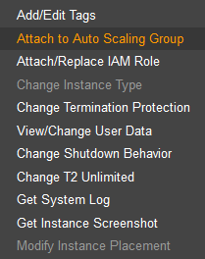
Auto Scaling – Example

Slide 8
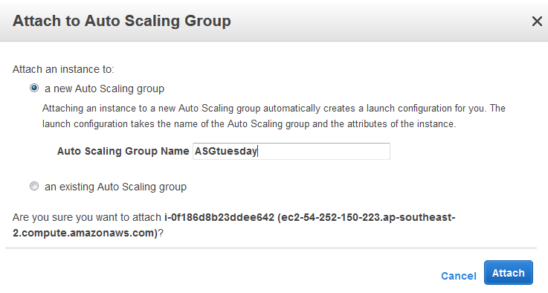
Auto Scaling – Example

Slide 9
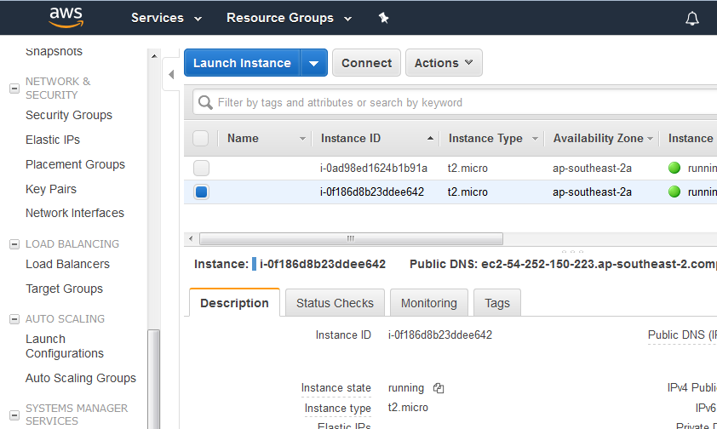
Auto Scaling – Example

Slide 10
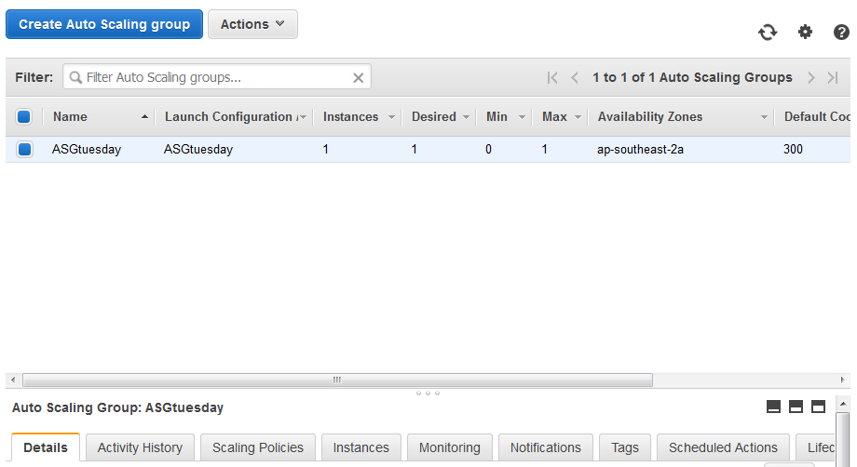
Auto Scaling – Example

Slide 11
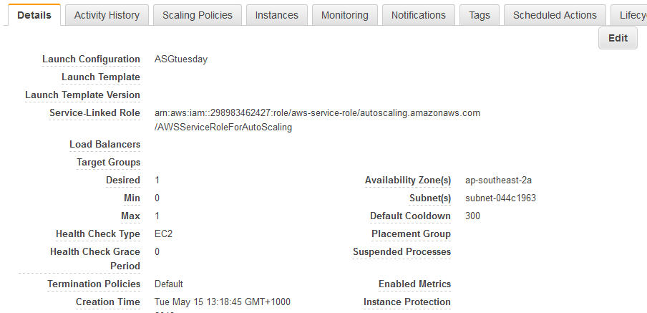
Auto Scaling – Example

Slide 12
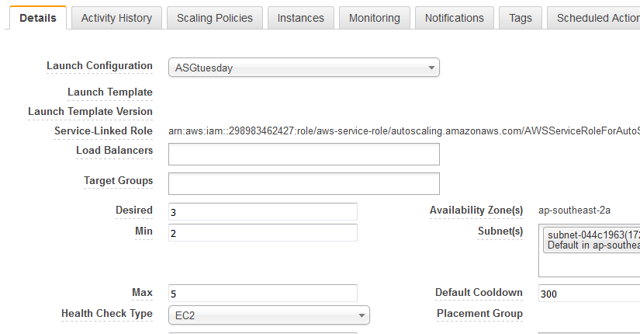
Auto Scaling – Example

Slide 13
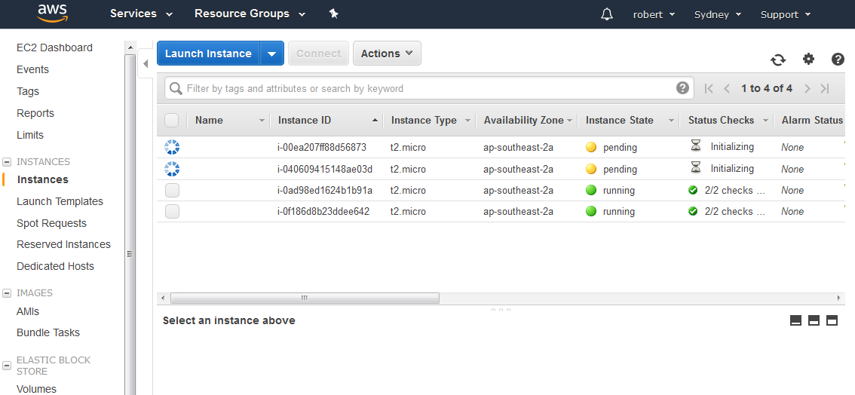
Auto Scaling – Example

Slide 14
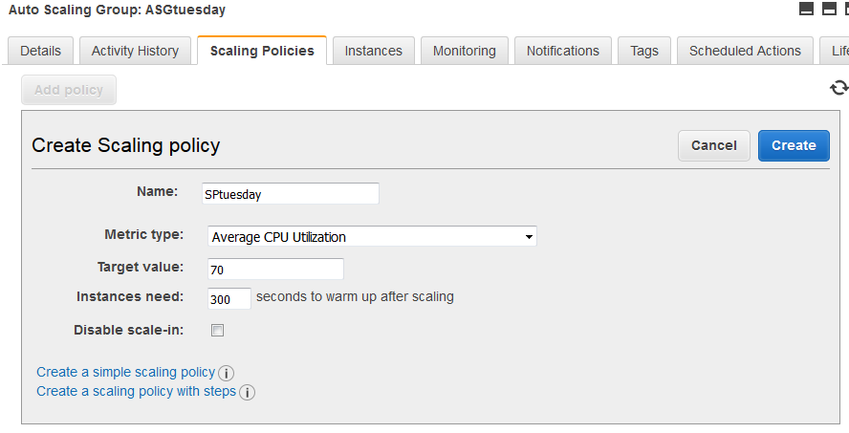
Auto Scaling – Example

Slide 15
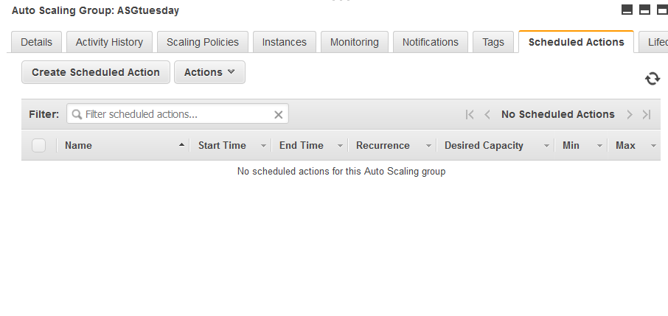
Auto Scaling – Example

Slide 16
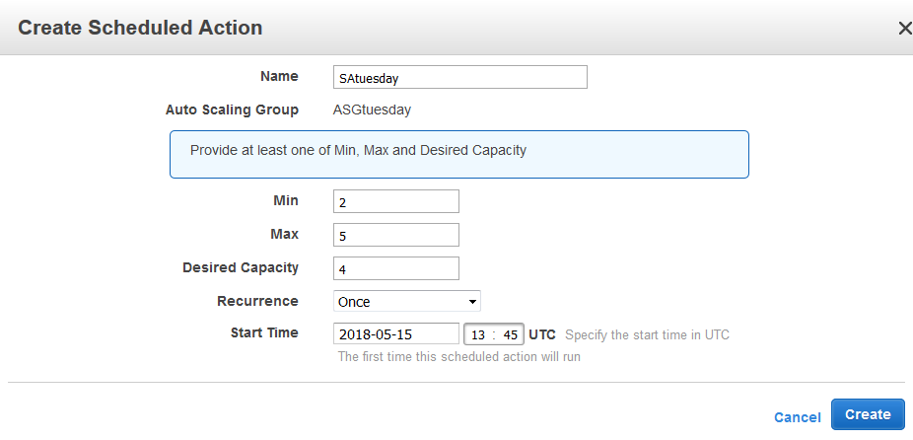
Auto Scaling – Example

Slide 17
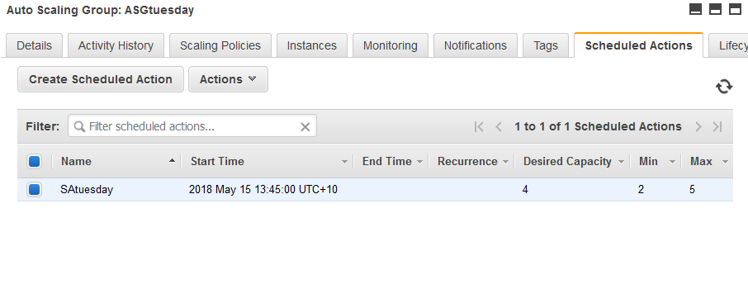
Auto Scaling – Example

Slide 18
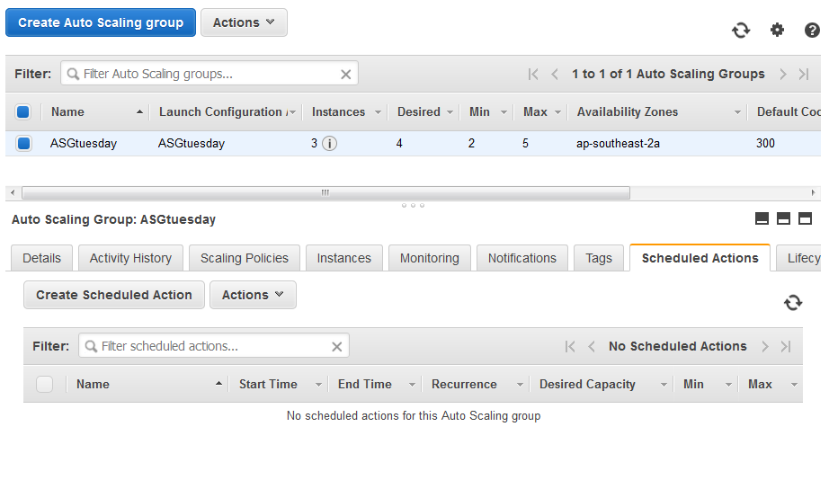
Auto Scaling – Example

Slide 19
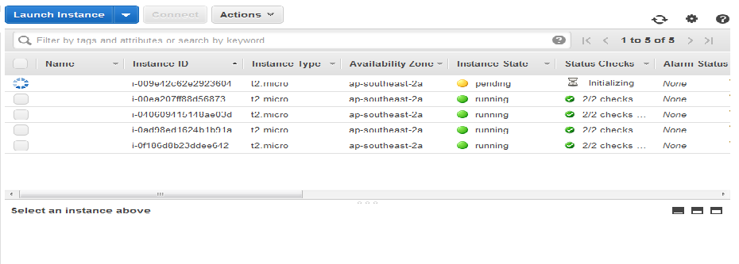
Auto Scaling – Example

Slide 20
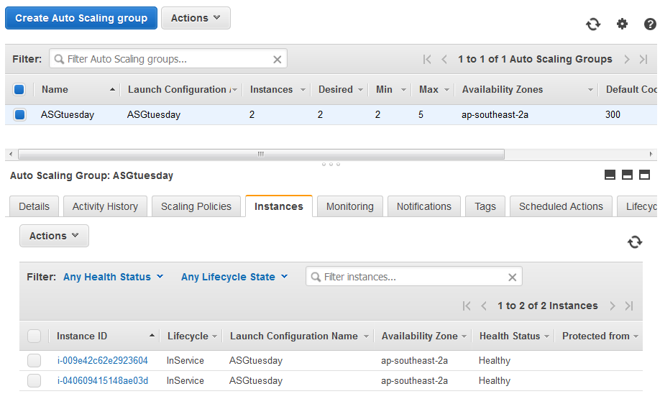
Auto Scaling – Example

Slide 21
Virtual Private Clouds
https://www.youtube.com/watch?v=Tff1mekxOJ4

Slide 22
Summary
AWS
Auto Scaling
Virtual Private Clouds

